Slide 1



University Institute of Engineering
DEPARTMENT OF COMPUTER SCIENCE & ENGINEERING
Subject Name: Software Engineering
Subject Code: 23CST-206
Software Testing
Er. Jagmeet Kaur
E8387
ASSISTANT PROFESSOR
CSE
DISCOVER . LEARN . EMPOWER

Slide 2
Chapter-7 Software Testing
Software Testing Fundamentals
Strategic Approach to Software Testing

Slide 3
Software Testing Fundamentals
Software testing can be stated as the process of verifying and validating that a software or application is bug free, meets the technical requirements as guided by its design and development and meets the user requirements effectively and efficiently with handling all the exceptional and boundary cases.

Slide 4
Software Testing Fundamentals
The process of software testing aims not only at finding faults in the existing software but also at finding measures to improve the software in terms of efficiency, accuracy and usability.
It mainly aims at measuring specification, functionality and performance of a software program or application.

Slide 5
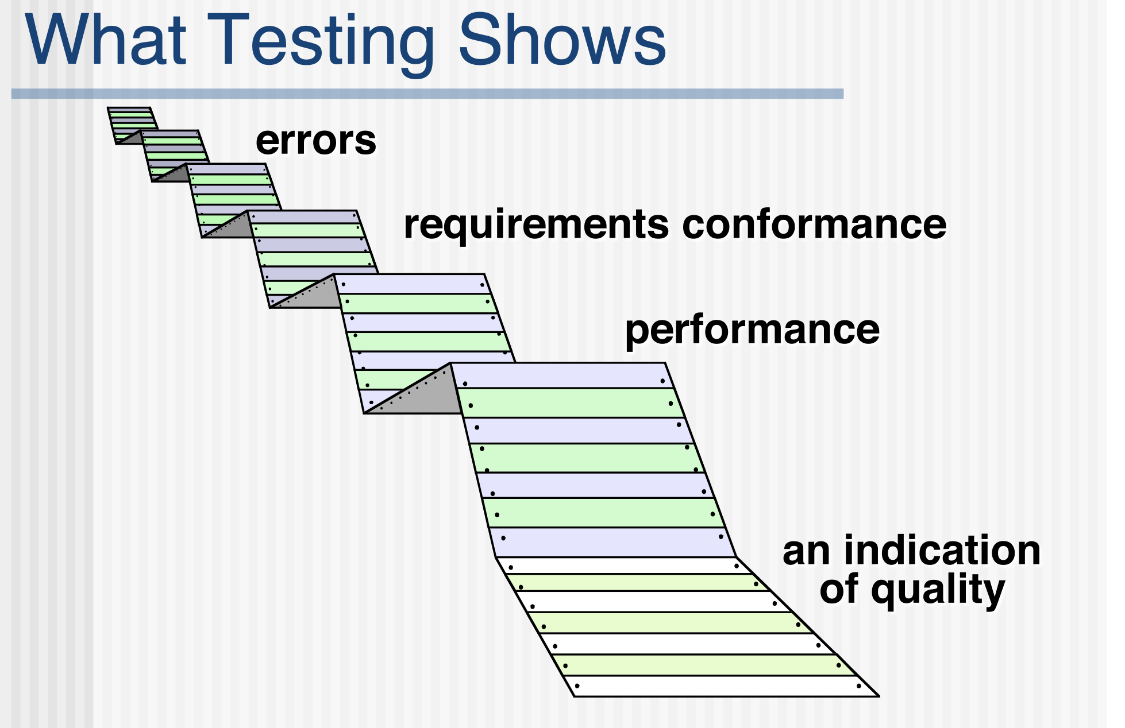

Slide 6
Software Testing Fundamentals
Software testing can be divided into two steps: (V & V)
1. Verification: it refers to the set of tasks that ensure that software correctly implements a specific function.
2. Validation: it refers to a different set of tasks that ensure that the software that has been built is traceable to customer requirements.
Verification: “Are we building the product right?”
Validation: “Are we building the right product?”

Slide 7
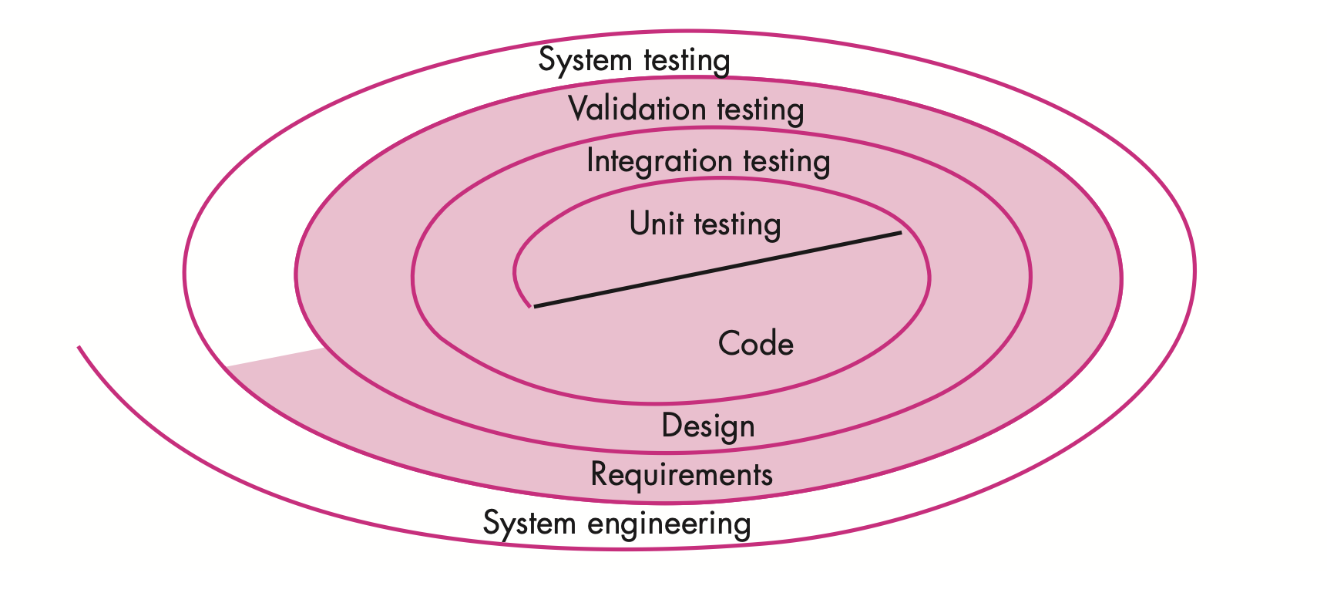
Testing Strategy:

Slide 8
A strategy for software testing may also be viewed in the context of the spiral:
Unit testing begins at the vortex of the spiral and concentrates on each unit (e.g., component, class, or WebApp content object) of the software as implemented in source code.
Testing progresses by moving outward along the spiral to integration testing, where the focus is on design and the construction of the software architecture.
Taking another turn outward on the spiral, you encounter validation testing, where requirements established as part of requirements modeling are validated against the software that has been constructed.
Finally, you arrive at system testing, where the software and other system elements are tested as a whole. To test computer software, you spiral out in a clockwise direction along streamlines that broaden the scope of testing with each turn.

Slide 9
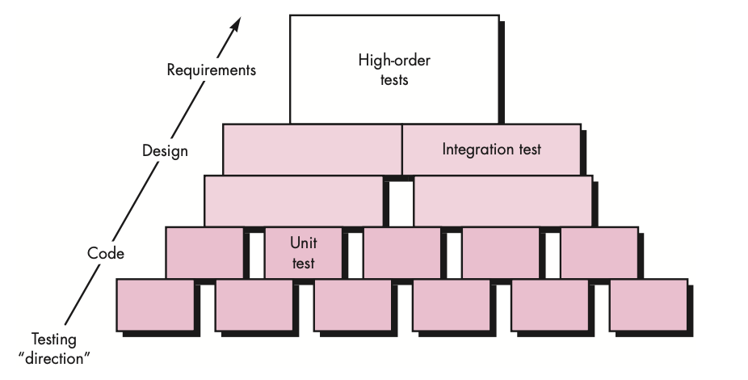
Software Testing Steps:

Slide 10
Unit Testing:
Initially, tests focus on each component individually, ensuring that it functions properly as a unit. Hence, the name unit testing.
Unit testing makes heavy use of testing techniques that exercise specific paths in a component’s control structure to ensure complete coverage and maximum error detection.

Slide 11
Integration Testing:
Next, components must be assembled or integrated to form the complete software package. Integration testing addresses the issues associated with the dual problems of verification and program construction.
Test case design techniques that focus on inputs and outputs are more prevalent during integration, although techniques that exercise specific program paths may be used to ensure coverage of major control paths.

Slide 12
Validation Testing
After the software has been integrated (constructed), a set of high-order tests is conducted. Validation criteria (established during requirements analysis) must be evaluated.
Validation testing provides final assurance that software meets all informational, functional, behavioral, and performance requirements.

Slide 13
System Testing
The last high-order testing step falls outside the boundary of software engineering and into the broader context of computer system engineering. Software, once validated, must be combined with other system elements (e.g., hardware, people, databases).
System testing verifies that all elements mesh properly and that overall system function/performance is achieved.

Slide 14
Software Testing Fundamentals
Software Testing can be broadly classified into two types:
1. Manual Testing: Manual testing includes testing a software manually, i.e., without using any automated tool or any script.
In this type, the tester takes over the role of an end-user and tests the software to identify any unexpected behavior or bug.
There are different stages for manual testing such as unit testing, integration testing, system testing, and user acceptance testing.
Testers use test plans, test cases, or test scenarios to test a software to ensure the completeness of testing.
Manual testing also includes exploratory testing, as testers explore the software to identify errors in it.

Slide 15
Software Testing Fundamentals
2. Automation Testing: Automation testing, which is also known as Test Automation, is when the tester writes scripts and uses another software to test the product.
This process involves automation of a manual process.
Automation Testing is used to re-run the test scenarios that were performed manually, quickly, and repeatedly.
Apart from regression testing, automation testing is also used to test the application from load, performance, and stress point of view.
It increases the test coverage, improves accuracy, and saves time and money in comparison to manual testing.

Slide 16
Software Testing Fundamentals
Bug, Fault & Failure Error
An error is a human action that produces the incorrect result that results in a fault.
Bug : The presence of error at the time of execution of the software.
Fault : State of software caused by an error.
Failure : Deviation of the software from its expected result. It is an event. A person makes an Error That creates a fault in software That can cause a failure in operation

Slide 17
Software Testing Fundamentals
Software Tester is the one who performs testing and find bugs, if they exist in the tested application.
Program Manager-
The planning and execution of the project to ensure the success of a project minimizing risk throughout the lifetime of the project.
Responsible for writing the product specification, managing the schedule and making the critical decisions and trade-offs.

Slide 18
Software Testing Fundamentals
QA Lead-
Coach and mentor other team members to help improve QA effectiveness
Work with other department representatives to collaborate on joint projects and initiatives
Implement industry best practices related to testing automation and to streamline the QA Department.

Slide 19
Software Testing Fundamentals
Test Analyst Lead
Responsible for planning, developing and executing automated test systems, manual test plans and regressions test plans.
Identifying the Target Test Items to be evaluated by the test effort
Defining the appropriate tests required and any associated Test Data
Gathering and managing the Test Data
Evaluating the outcome of each test cycle

Slide 20
Software Testing Fundamentals
Test Engineer
Writing and executing test cases and Reporting defects
Test engineers are also responsible for determining the best way a test can be performed in order to achieve 100% test coverage of all components

Slide 21
Software Testing Strategies
Software testing or Quality Assurance strategies describe how to mitigate product risks of stakeholders at the test level, which kinds of testing are to be done and which entry and exit criteria will apply.
They’re made based on development design documents.

Slide 22
FACTORS TO CONSIDER IN CHOOSING SOFTWARE TESTING STRATEGIES
RISKS. Risk management is paramount during testing, thus consider the risks and the risk level.
For an app that is well-established that’s slowly evolving, regression is a critical risk.
That is why regression-averse strategies make a lot of sense.
For a new app, a risk analysis could reveal various risks if choosing a risk-based analytical strategy.
OBJECTIVES. Testing should satisfy the requirements and needs of stakeholders to succeed. If the objective is to look for as many defects as possible with less up-front time and effort invested, a dynamic strategy makes sense.

Slide 23
FACTORS TO CONSIDER IN CHOOSING SOFTWARE TESTING STRATEGIES
SKILLS. Take into consideration which skills the testers possess and lack, since strategies should not only be chosen but executed as well.
A standard compliant strategy is a smart option when lacking skills and time in the team to create an approach.
PRODUCT. Some products such as contract development software and weapons systems tend to have requirements that are well-specified.
This could lead to synergy with an analytical strategy that is requirements-based.
BUSINESS. Business considerations and strategy are often important.
If using a legacy system as a model for a new one, one could use a model-based strategy.

Slide 24
FACTORS TO CONSIDER IN CHOOSING SOFTWARE TESTING STRATEGIES
REGULATIONS. At some instances, one may not only have to satisfy stakeholders, but regulators as well.
In this case, one may require a methodical strategy which satisfies these regulators.

Slide 25
STRATEGY IN SOFTWARE TESTING
The main objective of software testing is to design the tests in such a way that it systematically finds different types of errors without taking much time and effort so that less time is required for the development of the software.

Slide 26
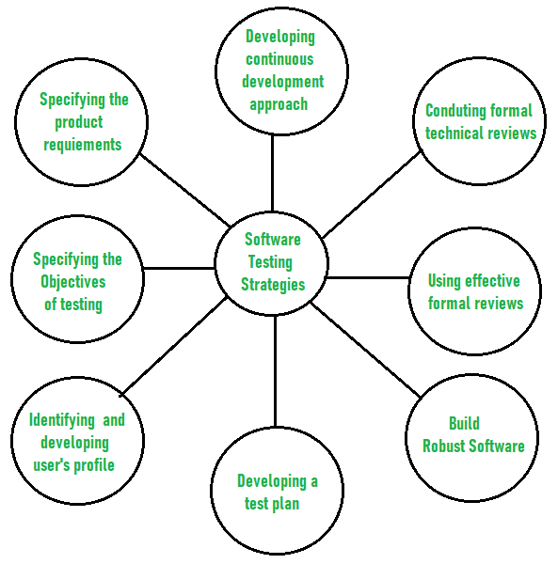
STRATEGY IN SOFTWARE TESTING
The overall strategy for testing software includes:

Slide 27
STRATEGY IN SOFTWARE TESTING
Before testing starts, it’s necessary to identify and specify the requirements of the product in a quantifiable manner: Different characteristics quality of the software is there such as maintainability that means the ability to update and modify, the probability that means to find and estimate any risk, and usability that means how it can easily be used by the customers or end-users. All these characteristic qualities should be specified in a particular order to obtain clear test results without any error.
Specifying the objectives of testing in a clear and detailed manner. Several objectives of testing are there such as effectiveness that means how effectively the software can achieve the target, any failure that means inability to fulfill the requirements and perform functions, and the cost of defects or errors that mean the cost required to fix the error. All these objectives should be clearly mentioned in the test plan.

Slide 28
STRATEGY IN SOFTWARE TESTING
For the software, identifying the user’s category and developing a profile for each user. Use cases describe the interactions and communication among different classes of users and the system to achieve the target. So as to identify the actual requirement of the users and then testing the actual use of the product.
Developing a test plan to give value and focus on rapid-cycle testing. Rapid Cycle Testing is a type of test that improves quality by identifying and measuring the any changes that need to be required for improving the process of software. Therefore, a test plan is an important and effective document that helps the tester to perform rapid cycle testing.

Slide 29
STRATEGY IN SOFTWARE TESTING
Robust software is developed that is designed to test itself. The software should be capable of detecting or identifying different classes of errors. Moreover, software design should allow automated and regression testing which tests the software to find out if there is any adverse or side effect on the features of software due to any change in code or program.
Before testing, using effective formal reviews as a filter. Formal technical reviews is technique to identify the errors that are not discovered yet. The effective technical reviews conducted before testing reduces a significant amount of testing efforts and time duration required for testing software so that the overall development time of software is reduced.

Slide 30
STRATEGY IN SOFTWARE TESTING
Conduct formal technical reviews to evaluate the nature, quality or ability of the test strategy and test cases.
The formal technical review helps in detecting any unfilled gap in the testing approach. Hence, it is necessary to evaluate the ability and quality of the test strategy and test cases by technical reviewers to improve the quality of software.
For the testing process, developing a approach for the continuous development.
As a part of a statistical process control approach, a test strategy that is already measured should be used for software testing to measure and control the quality during the development of software.

Slide 31
References
https://www.geeksforgeeks.org/software-testing-strategies/
https://www.browserstack.com/guide/software-testing-strategies-and-approaches
https://www.slideshare.net/Chankey007/software-testing-6644248
https://www.tutorialspoint.com/software_engineering/software_testing_overview.htm
https://www.geeksforgeeks.org/software-testing-basics/

Slide 32
THANK YOU

